Slide 1
Life Coach
Patrick Zambri, Bradford Harris, Marisa Proscia, Chris Siena, Jacob Levinson

Slide 2
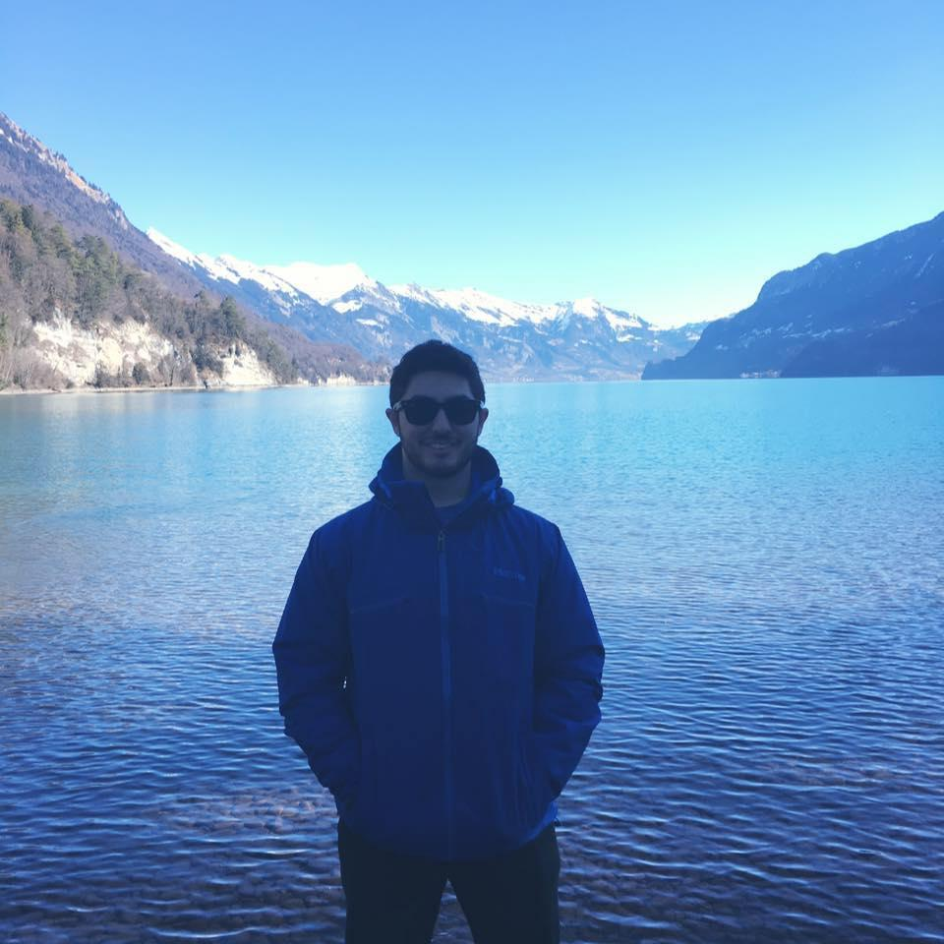
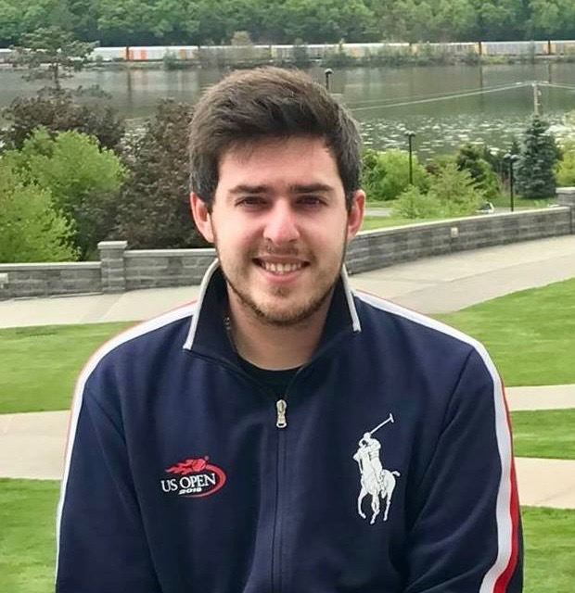
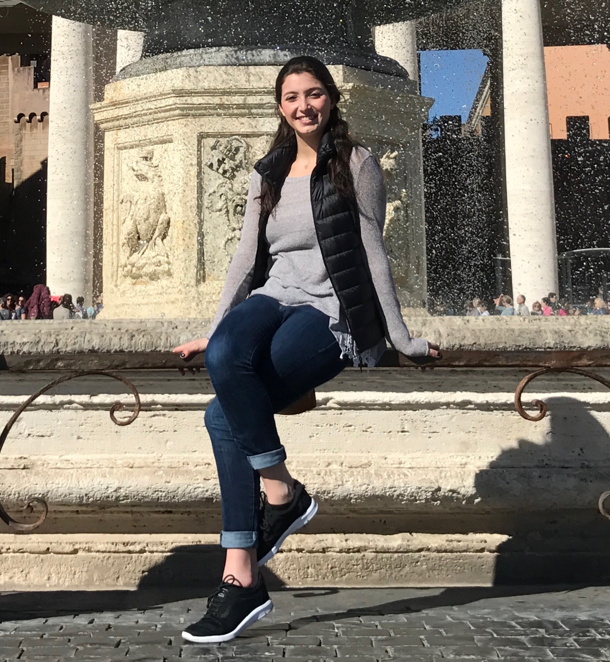
Team Pictures

Slide 3
Decision Required
 | Schedule | We are adhering to our development schedule.
 | Technical | We are developing our database and server. We marked this as yellow because it is still in progress, but we are confident that we will continue to make further progress without impediments.
 | Resource | We currently have outstanding client questions.
 | Other | N/A

Slide 4
Project Status
Accomplishments
Completed Homework 1
Designed a project plan for the semester
Gathered Requirements with client interview
Created Use Case Diagram and Documentation
Defined User Requirements
Completed Homework 2
ER Diagram and Documentation
IT Requirements
Activities being worked
Server setup, website design prototyping, database setup

Slide 5
Scope of Project
What it is | What it is not
A website and mobile application | A desktop application

Slide 6
Schedule
Week | Requirements | Development | Testing | Members
1 | Gather Requirements | Go over project overview and client expectations. Create questions based on project overview. |  | All
2 | Gather Requirements | Create Status Report for following class. Organizes weekly updates with team to ensure. requirements are met, and productivity is high. Ensure detailed documentation is completed weekly as development continues. |  | All Brad Brad
3 | Create use cases Create Database File Homework 1 due | Create UML Diagram & documentation. Create User Requirements based on client question panel and project overview. Create PHP file that has connection string & function call for Database. Continue Documentation and Requirement Gathering. |  | All Chris Brad All
4 | Create website framework. Create website design/UI prototype. Create ER Diagrams. Homework 2 due | Create basic website in PHP. Create website design/UI prototype mockups. Create ER Diagram. Set up virtual environment. Apply design standards to website design/UI prototype mockups. Implement UI mockups in website prototype. |  | Chris All Patrick Patrick Brad Marisa, Jacob, Chris All
5 | Begin work on basic functionality of website and features Homework 3 due | Finalize website UI mockups. Compare mockups to client specifications. |  | Marisa, Jacob, Chris Brad All

Slide 7
Project Risks
Risk | Score | Mitigation
As we are still in the early development process, our only risk is the timeframe in which we must complete the project. | High | Ensuring our project plan is followed. Team meeting twice a week to touch base on development progress and reevaluate the schedule of our project.

Slide 8
Project issues
Issue | Owner | Action Plan | Checkpoint Date
No issues...yet.

Slide 9
Lessons Learned
Lessons Learned | Corrective Action / Recommendation
Gathering user requirements is the most important part of the design process. It helps avoid miscommunication or an unsatisfied client. | Double check with the client at the beginning of development, and continue to keep in touch through the development process to ensure that all requirements are being met.

